Slide 1




Getting Started with Deep Learning using Keras
Ogban-Asuquo Ugot
ogbanugot@gmail.com @ogbanugot ogbanugot

Slide 2
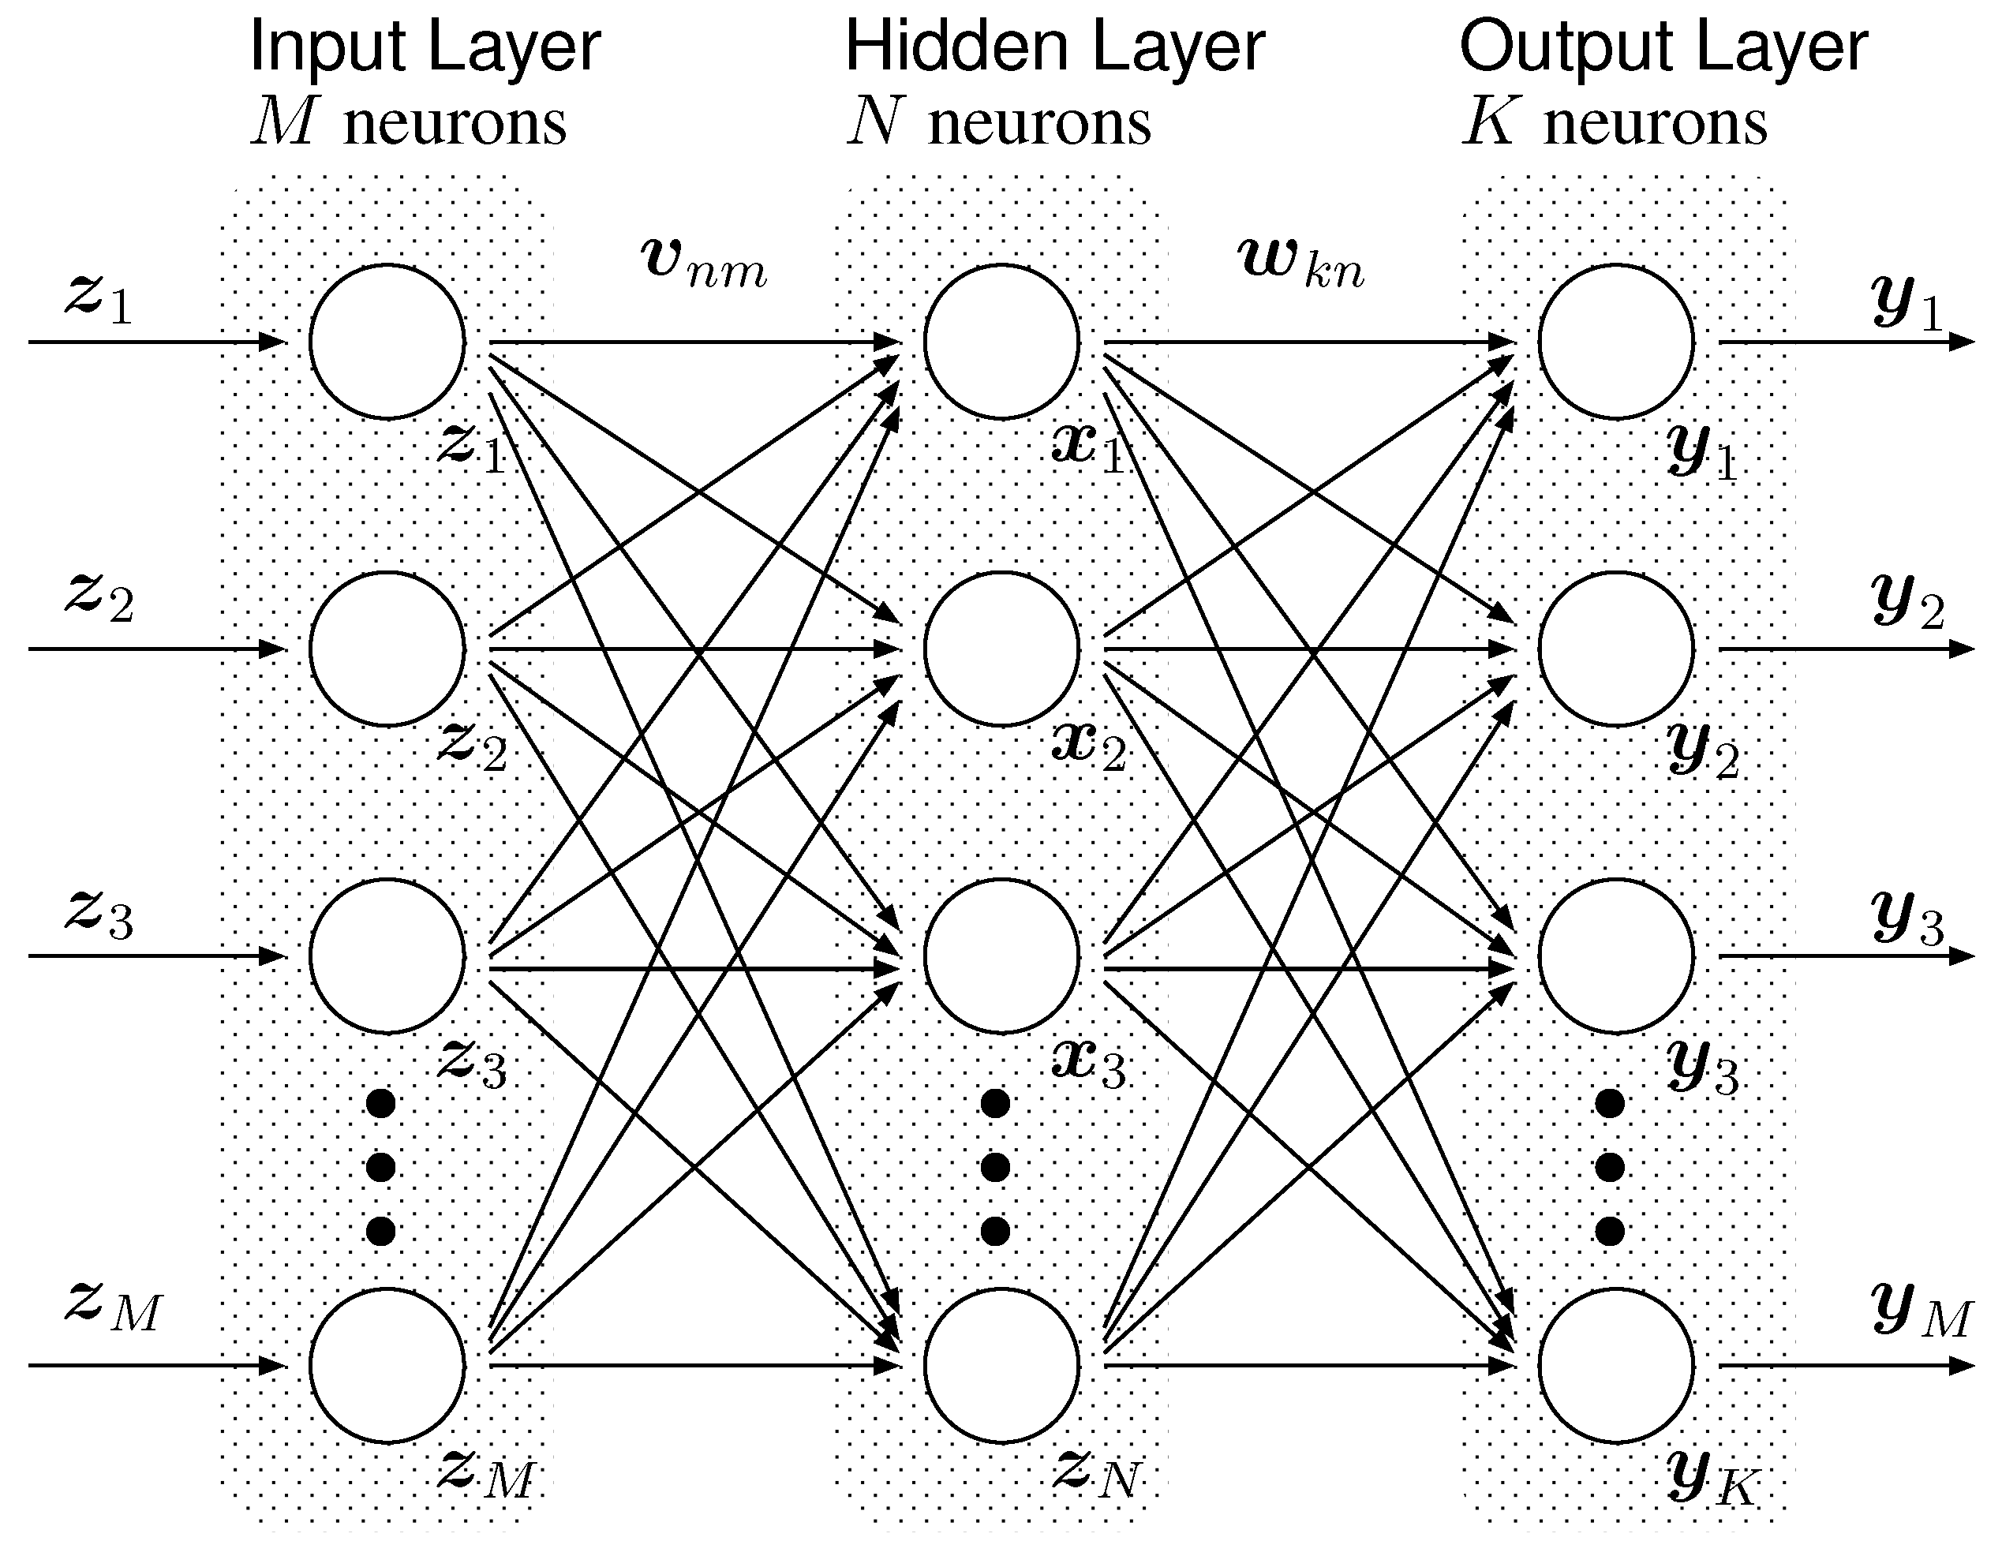
Outline
Theory session (Time: 50 minutes):
Introduction
What is Deep learning
Deep Learning Architecture
How do Neural Networks work?
Activation functions and output nodes
How do Neural Networks learn?
Cost functions
Backpropagation
Gradient descent
Modern practices in deep learning
Deep learning and hardware requirements
Limitations of Deep learning
Summary
Q&A session (Time: 10 minutes)

Slide 3
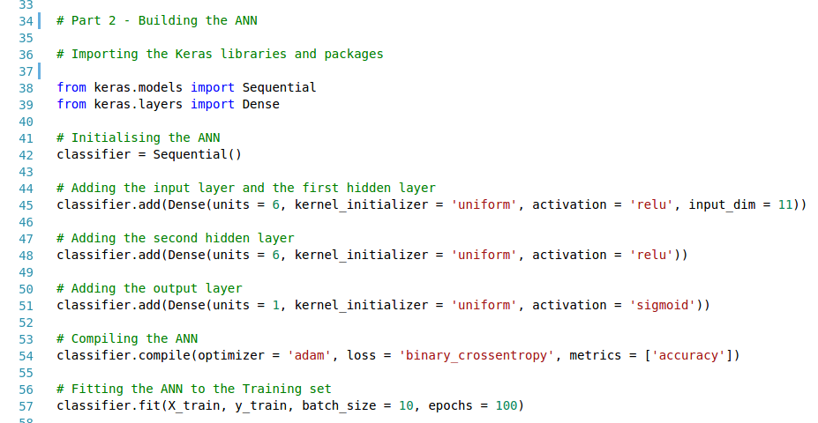
Outline
Practical session (Time: 40 minutes):
About Keras
Data preprocessing
Building the ANN
Training the ANN
Testing the ANN
Plotting, saving and loading Keras models
Source Code:
https://github.com/ogbanugot/Artificial-Neural-Network-

Slide 4
Theory Session

Slide 5
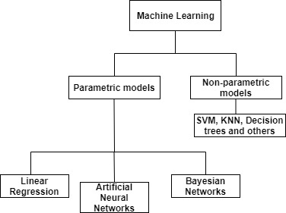
Introduction
Artificial Intelligence (AI) concerns itself with designing intelligent agents capable of rational decision making in an environment
Machine learning models learn without being explicitly programmed to do so. The learning model may enhance the AI’s performance
Artificial Neural Networks (ANNs) are a type of machine learning model for learning abstract data representations.
Machine learning taxonomy

Slide 6
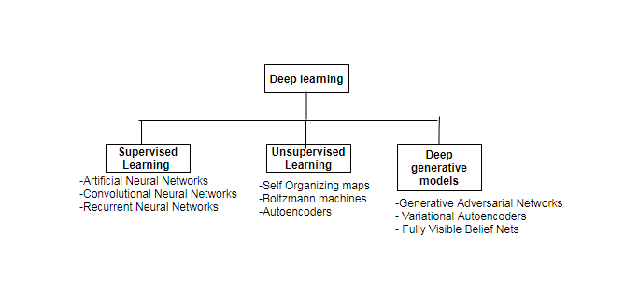
What is Deep Learning?
Deep learning is an advanced architecture for artificial neural networks that can learn data representations from larger and more complex datasets.
Deep learning is built on concepts from the basic Multilayer Perceptron.
The “deep” in deep learning implies that the multilayer perceptron has multiple hidden layers.
Deep learning makes use of modern optimization and regularization techniques to achieve improved performance.
Deep learning taxonomy

Slide 7
Deep Neural Network Architecture
Deep neural networks (DNNs) consists of computational nodes ( artificial neurons) arranged in layers.
The layer that takes in input from a dataset is the input layer.
The layer that gives us our final output is the output layer.
Hidden layers are everything in between (the input and output layer) and are called “hidden” because their output is not defined in the dataset and therefore must be optimized.
A three layer feed forward network

Slide 8
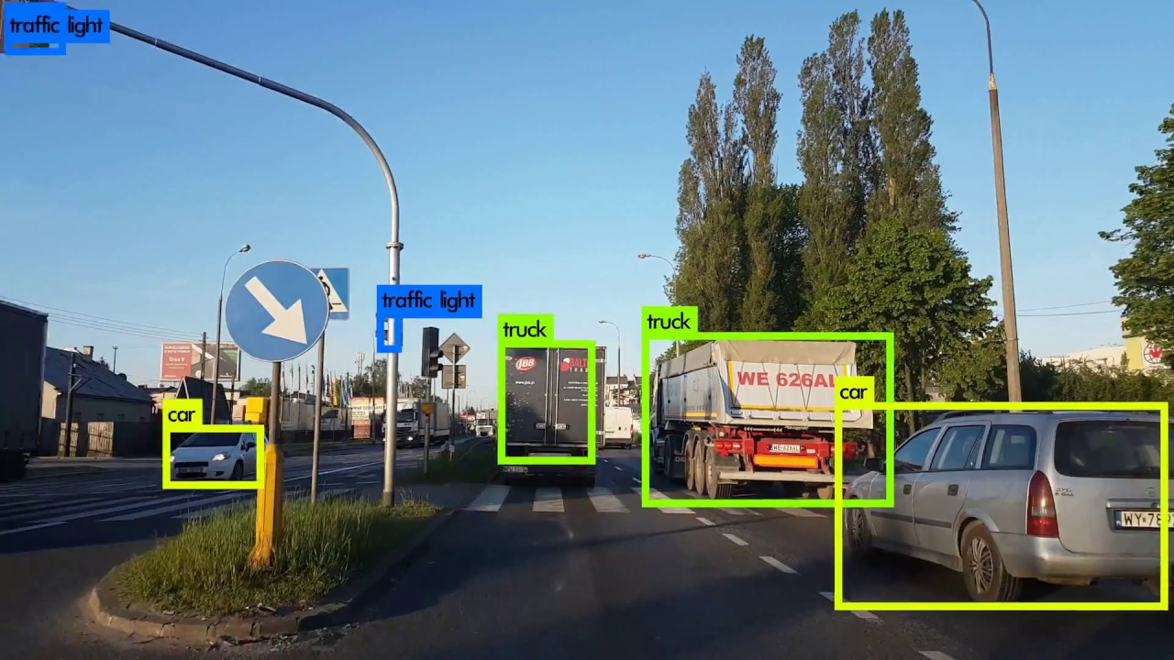

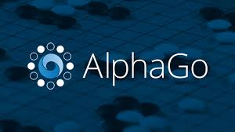
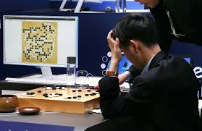
Applying Deep Neural Nets
Speech recognition
Computer vision object detection tasks
Expert systems capable of outperforming any human

Slide 9
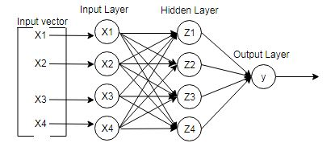
How do neural networks work?
Given the 3 layer neural network;

Slide 10
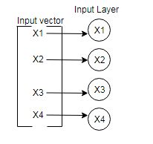
How do Neural Networks work?
1. Input is fed into the network
An input vector is fed to the input layer, a vector unit to one input node.

Slide 11
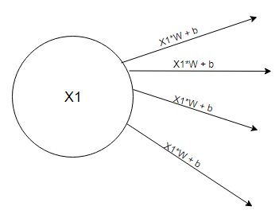

How do Neural Networks work?
2. Each input node is computed with its weights (W) and bias (b)

Slide 12
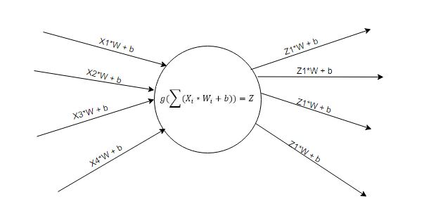
How do Neural Networks work?
3. The output from an input node is fed to every node of the next layer, the hidden layer.
Each node of the hidden layer performs a summation of all incoming signals, applies an activation function to this summation and sends its output to all the nodes of the next layer, which maybe a hidden layer or an output layer.

Slide 13
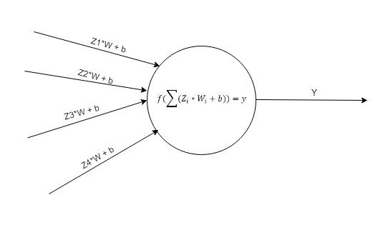
How do Neural Networks work?
4. If the next layer is an output layer, the output node computes the summation of all incoming signals and transforms this sum with a function to get the output.
Else if the next layer is a hidden layer, step 3 is repeated this time from a hidden layer to another hidden layer, until it gets to the output layer.

Slide 14
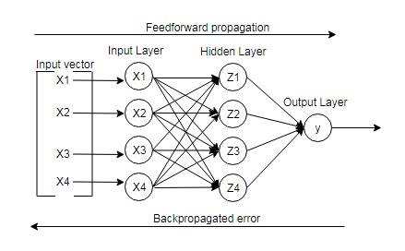
How do Neural Networks work?
The output from a neural network is an estimate of a real value defined in our dataset.
The process of flowing an input through the network to get an estimated output is know as the feedforward propagation.
The difference between the estimated output and a real output is known as the error.
This error is back propagated through the network in a backward direction and is the crucial step in making neural networks learn.
The backpropagation algorithm describes how to flow the error signal backwards.
Fully Connected Neural Network

Slide 15
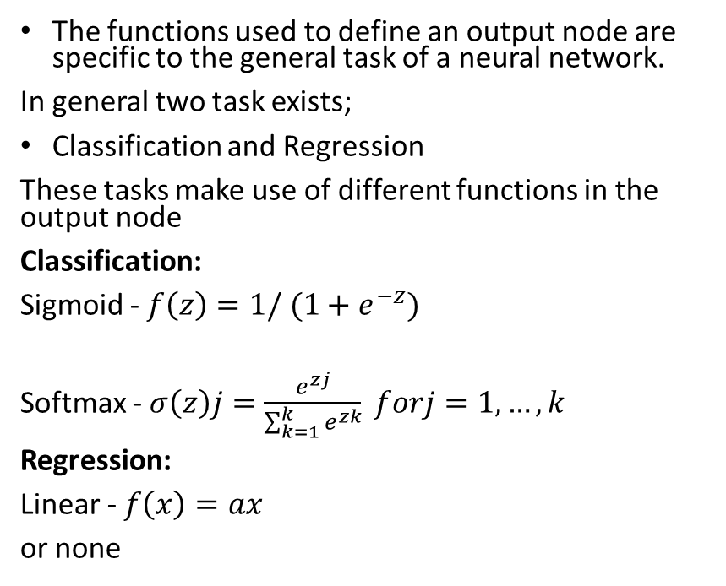
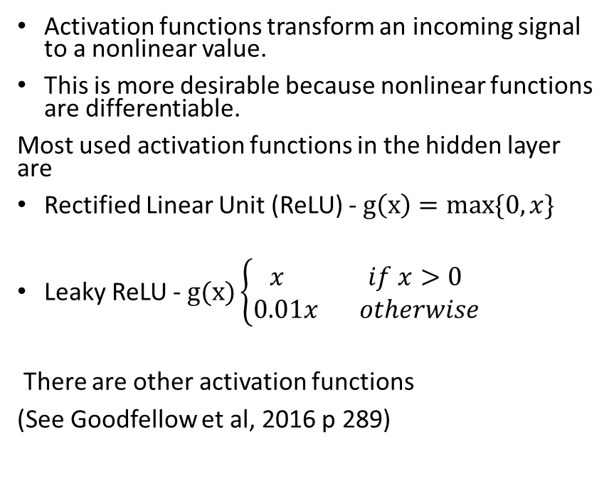
Activation functions and output nodes
Activation Functions
Output nodes
Activation functions transform an incoming signal to a nonlinear value.
This is more desirable because nonlinear functions are differentiable.
Most used activation functions in the hidden layer are
Rectified Linear Unit (ReLU) - $g\left(x\right)=max\{0,x\}$
Leaky ReLU - $g(x)\left\{\begin{aligned}x if x>0 \\ 0.01x otherwise\end{aligned}\right.$
There are other activation functions
(See Goodfellow et al, 2016 p 289)
The functions used to define an output node are specific to the general task of a neural network.
In general two task exists;
Classification and Regression
These tasks make use of different functions in the output node
Classification:
Sigmoid - $f\left(z\right)=1/ (1+e^{−z})$
Softmax - $σ\left(z\right)j=\frac{e^{zj}}{\sum_{k=1}^{k}{e^{zk}}} forj=1,…,k$
Regression:
Linear - $f\left(x\right)=ax$
or none

Slide 16
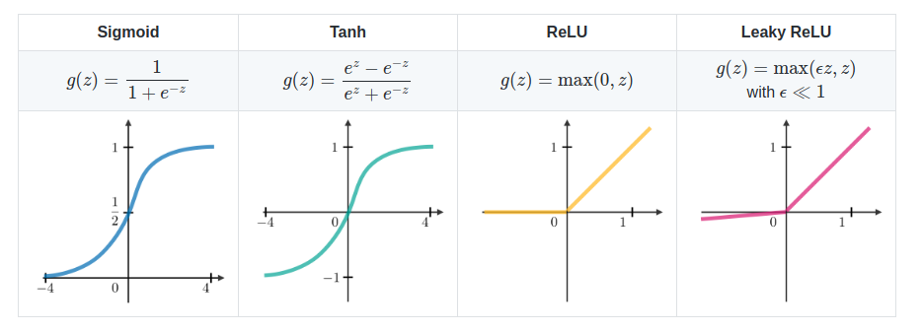
Activation functions
Source: CS 229 – Machine learning

Slide 17
How do Neural Networks Learn?
Feedforwarding propagation
Take input vector
Calculate the output from each node in each layer.
Compare the difference between the estimated output of the neural network and the desired output. The difference is known as the error.
Calculate this error using a cost function.

Slide 18
How do Neural Networks Learn?
Backward propagation
(Backpropagation)
Back-propagate the calculated error by estimating the gradient of each node in the neural network, from the output layer down to the first hidden layer;
Update the weights of the neural network so as to minimize the error in the next feedforward processing.

Slide 19
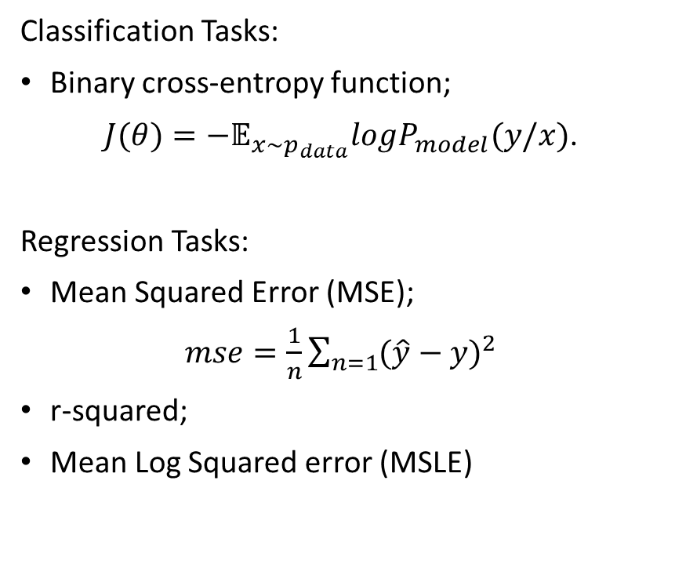
Cost functions
A cost function is simply the objective function a deep neural network is trying to minimize
It is a measure of how wrong the model is in terms of its ability to estimate the desired output
The choice of a cost function is extremely important and we can choose a cost function with respect to the machine learning task.
Classification Tasks:
Binary cross-entropy function;
$J(θ)=−𝔼_{x\sim p_{data}}logP_{model}(y/x)$.
Regression Tasks:
Mean Squared Error (MSE);
$mse=\frac{1}{n}\sum_{n=1}{{(\hat{y}−y)}^{2}}$
r-squared;
Mean Log Squared error (MSLE)

Slide 20
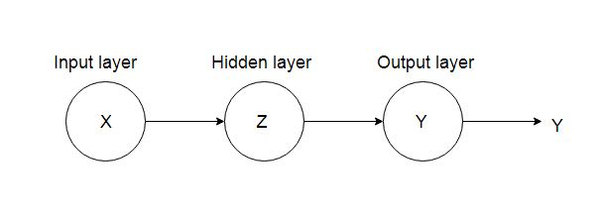
Backpropagation
We already know that the backpropagation algorithm is used to train the artificial neural network,
Now lets learn how it works in more detail.
To begin our discussion of backpropagation,
Let us visualize (for simplicity) the neural network on the left as the single path queue on the right.

Slide 21
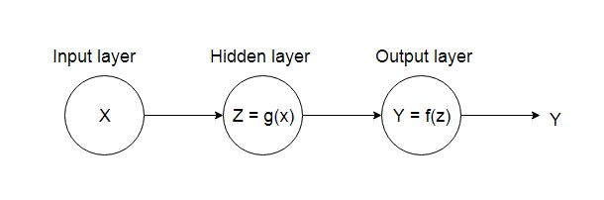
Backpropagation
The neural network in the diagram consists of
x - an input;
g(x) – the activation function in the hidden layer and
f(z) the activation function in the output layer.
The output of g(x) is z
The output of f(z) is y (the final output of the neural network)
Next we define the neural network with its activation function
and output node;

Slide 22
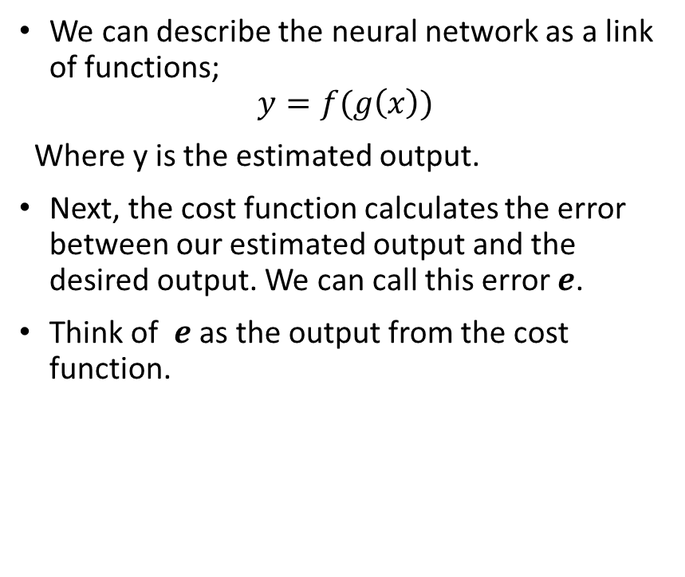
Backpropagation
We can describe the neural network as a link of functions;
$$y=f(g\left(x\right))$$
Where y is the estimated output.
Next, the cost function calculates the error between our estimated output and the desired output. We can call this error $e$.
Think of $e$ as the output from the cost function.

Slide 23
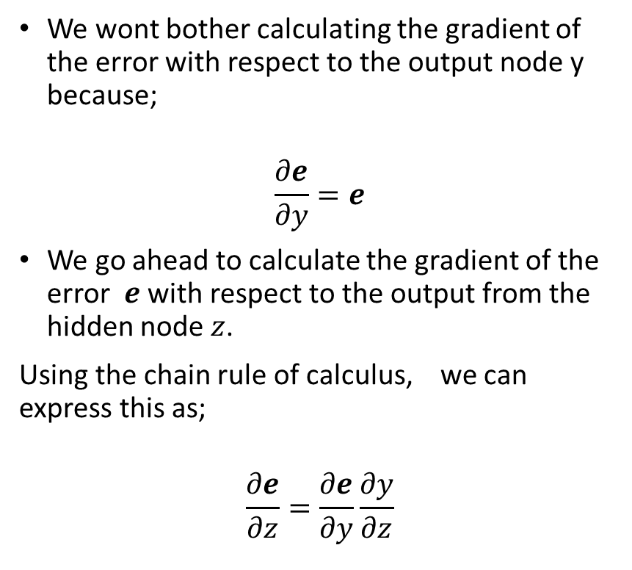
Backpropagation
We wont bother calculating the gradient of the error with respect to the output node y because;
$$\frac{∂e}{∂y}=e$$
We go ahead to calculate the gradient of the error $e$ with respect to the output from the hidden node $z$.
Using the chain rule of calculus, we can express this as;
$$\frac{∂e}{∂z}=\frac{∂e}{∂y}\frac{∂y}{∂z}$$

Slide 24
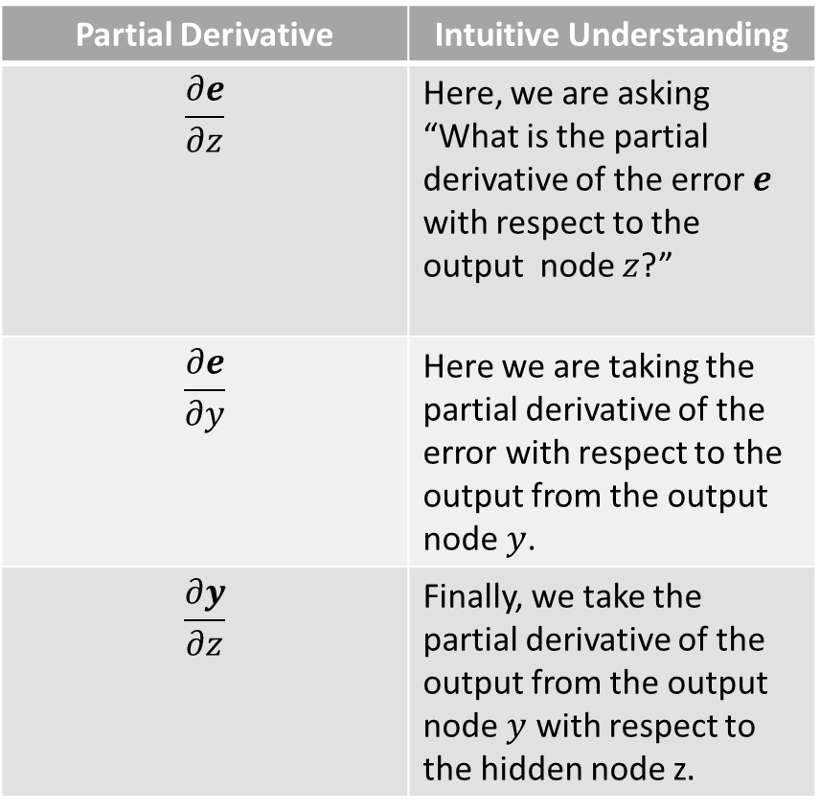
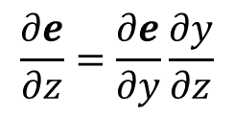
Backpropagation
Let’s break down the equation
Partial Derivative | Intuitive Understanding
$$\frac{∂e}{∂z}$$ | Here, we are asking “What is the partial derivative of the error $e$ with respect to the output node $z$?”
$$\frac{∂e}{∂y}$$ | Here we are taking the partial derivative of the error with respect to the output from the output node $y$.
$$\frac{∂y}{∂z}$$ | Finally, we take the partial derivative of the output from the output node $y$ with respect to the hidden node z$.$
$$\frac{∂e}{∂z}=\frac{∂e}{∂y}\frac{∂y}{∂z}$$
Chain rule for the gradient of the error with respect
to the hidden node z

Slide 25
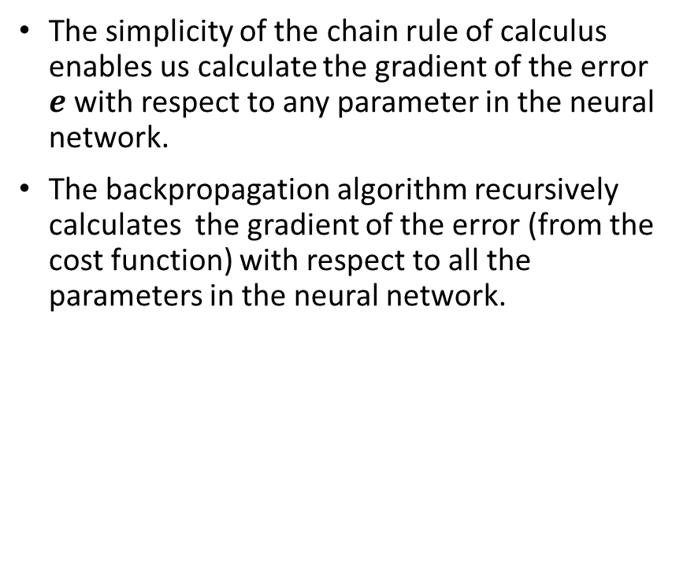
Backpropagation
The simplicity of the chain rule of calculus enables us calculate the gradient of the error $e$ with respect to any parameter in the neural network.
The backpropagation algorithm recursively calculates the gradient of the error (from the cost function) with respect to all the parameters in the neural network.
$$\frac{∂e}{∂z}=\frac{∂e}{∂y}\frac{∂y}{∂z}$$
Chain rule for the gradient of the error with respect
to the hidden node z

Slide 26
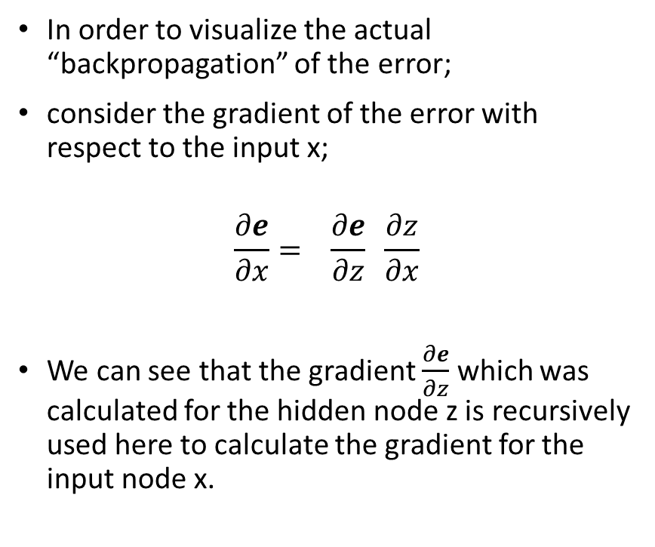



Backpropagation
In order to visualize the actual “backpropagation” of the error;
consider the gradient of the error with respect to the input x;
$$\frac{∂e}{∂x}= \frac{∂e}{∂z} \frac{∂z}{∂x}$$
We can see that the gradient $\frac{∂e}{∂z}$ which was calculated for the hidden node z is recursively used here to calculate the gradient for the input node x.
$$\frac{∂e}{∂z}$$
$$\frac{∂e}{∂z}=\frac{∂e}{∂y}\frac{∂y}{∂z}$$
Chain rule for the gradient of the error with respect
to the hidden node z
$$\frac{∂e}{∂z}$$

Slide 27
Backpropagation
In Summary;
We estimate an error using a cost function;
Then, starting from the last hidden layer in the neural network, we find the gradient of the error with respect to each node in that layer and repeat this process for each layer until we work our way backwards to the first hidden layer. This is the backpropagation processing;
The backpropagation algorithm is actually executed in two phases for each layer in the network. First we calculate the gradients, then we update the weights of the neural network using the gradients. The update of the weights is what enables the actual “learning”.

Slide 28
Gradient Descent
What is the motivation for an optimization algorithm for deep learning?
Simply put, given the parameters of the deep learning model, we cannot precisely determine that we have found the global minimum of the cost function we are trying to minimize.
One can think of the deep neural network as one big non-linear function. The optimization of a deep learning model is therefore non-convex.
Therefore, we need an optimization algorithm to help find the global minimum of the cost function.
Enter Gradient Descent....

Slide 29
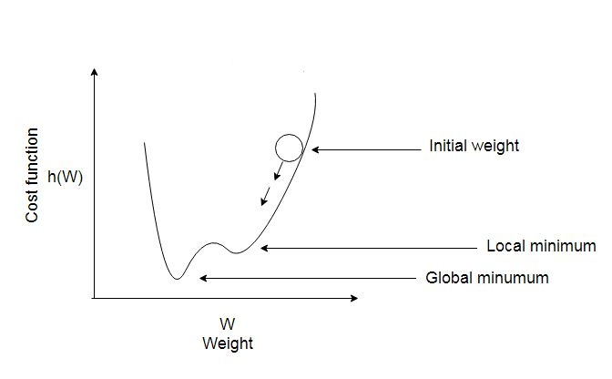
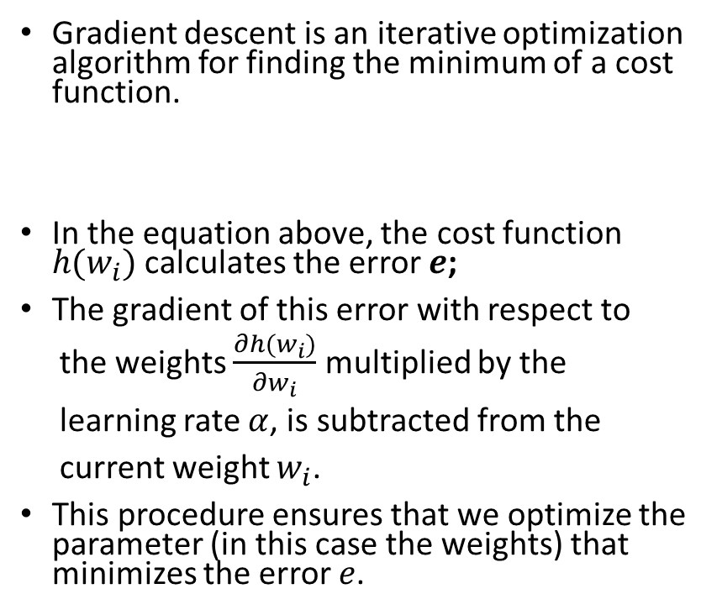
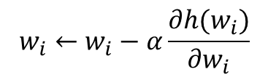
Gradient Descent
Gradient descent is an iterative optimization algorithm for finding the minimum of a cost function.
In the equation above, the cost function $h(w_{i})$ calculates the error $e$;
The gradient of this error with respect to
the weights $\frac{∂h(w_{i})}{∂w_{i}}$ multiplied by the
learning rate $α$, is subtracted from the
current weight $w_{i}$.
This procedure ensures that we optimize the parameter (in this case the weights) that minimizes the error $e$.
$$w_{i}←w_{i}−α\frac{∂h(w_{i})}{∂w_{i}}$$
Visualizing the gradient descent algorithm

Slide 30
Gradient Descent
Modern implementations of gradient descent make use of extensions of the gradient descent algorithm grouped under the umbrella term Stochastic Gradient Descent (SGD).
Stochastic because samples from the dataset are selected randomly as opposed to the standard gradient descent algorithm where samples are selected in-order.
This stochastic sampling has shown to improve the optimization procedure and thus find a much preferable minimum for the cost function. Variants of the SGD include;
Adaptive Moment Estimation (ADAM)
Adaptive Gradient (AdaGrad)
Root Mean Squared Propagation (RMSProp)

Slide 31
How do Neural Networks learn? Revisited
Feedforwarding propagation
Backward propagation
(Backpropagation)
Take input vector
Calculate the output from each node in each layer.
Compare the difference between the estimated output of the neural network and the desired output. The difference is known as the error.
Calculate this error using a cost function.
Back-propagate the calculated error by estimating the gradient of each node in the neural network, from the output layer down to the first hidden layer;
Using an optimization algorithm, update the weights of the neural network so as to minimize the error in the next feedforward processing.

Slide 32
Modern practices in deep learning
Let us briefly define some important practices essential to the success of modern implementations of large scale deep learning models;
Regularization: any modification we make to the learning algorithm that is intended to reduce the generalization error, but not its training error (Goodfellow et al 2016 p 228).
Example of a regularization technique is dropout, where we randomly remove some nodes in the network along with all of their incoming and outgoing connections. Helps, with reducing overfitting.
Batch normalization: To increase the stability of a neural network, batch normalization normalizes the output of a previous activation layer by subtracting the batch mean and dividing by the batch standard deviation.

Slide 33
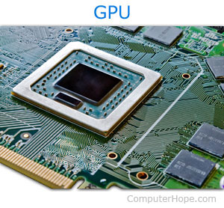



Deep learning and hardware requirements
Training large scale deep learning models takes time, and therefore requires expensive hardware resources;
Parallel processing with Graphical Processing Units
enables training of very large DNNs.
However, buying GPU hardware is expensive.
Cloud machine learning services provide
affordable compute power

Slide 34
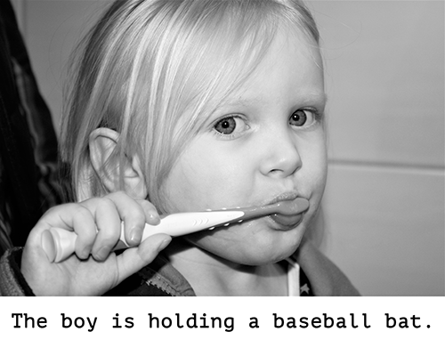
Limitations of Deep learning
Deep neural networks map an input space to an output space and are therefore sensitive to changes in the input data
Adversarial systems can take advantage of modifications in the input data to fool deep neural networks
The high reliance on data, annotated or otherwise restricts the deep neural networks ability to generalize
Deep neural networks lack any abstract “thinking” or “reasoning” models and perform poorly on tasks that require reasoning and strategic planning.
An example of an image caption error
Image Source: Keras blog

Slide 35
Theory Session Recap
The strength of Deep learning models is that they are capable of learning extremely complex and abstract data representation.
The architecture of a deep learning model concerns the number of layers in the model, the number of computational units (nodes), activation functions and cost functions.
The backpropagation algorithm is the primary training algorithm for deep neural networks.
Stochastic gradient descent is the primary optimization algorithm used to update the parameters of deep neural network
The success of modern deep learning implementations can be attributed to the availability of large datasets, powerful computing hardware, modern optimization algorithms and hyperparameter tuning techniques.
Deep learning models have achieved the state-of-the-art in image classification, speech recognition and mobile robotics.
Deep learning has its limitations which include, weak generalization and poor performance in reasoning and planning tasks.

Slide 36
Further reading
Russell, S.J. and Norvig, P., 2016. Artificial intelligence: a modern approach. Malaysia; Pearson Education Limited.
Goodfellow, I., Bengio, Y., Courville, A. and Bengio, Y., 2016. Deep learning (Vol. 1). Cambridge: MIT press.

Slide 37
Practical Session

Slide 38
Outline
Practical session (Time: 50 minutes):
About Keras
Data preprocessing
Building the ANN
Training the ANN
Testing the ANN
Plotting, saving and loading Keras models
Source Code:
https://github.com/ogbanugot/Artificial-Neural-Network-

Slide 39
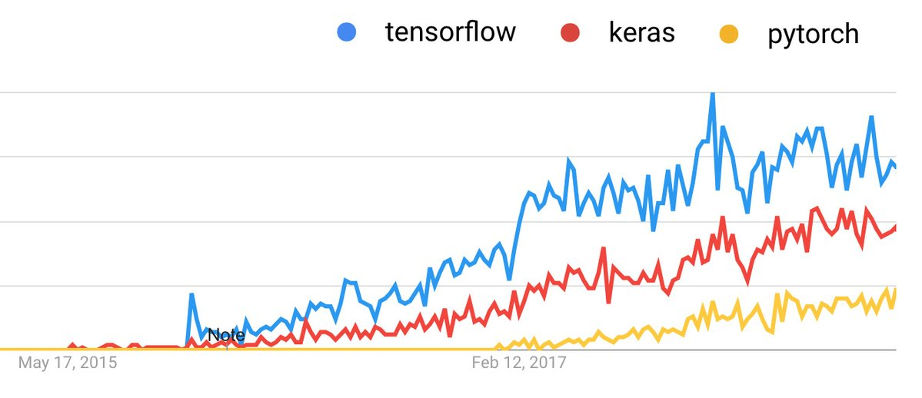
About Keras
Keras is an open source deep learning library
Keras initial release was in 2015 and its original author is François Chollet.
Keras is a high level API for deep learning libraries such as Tensorflow and Theano
Keras is easy to use and very well documented.
It abstracts a lot of the complexity of working with lower level libraries without trading functionality and performance.
Today, there is actually no “keras or Tensorflow” option. As at Tensorflow 1.9, Keras has been adopted as the official API for tensorflow with the inclusion of the tf.keras module in the tensorflow build.
Looking at Keras popularity over the years

Slide 40
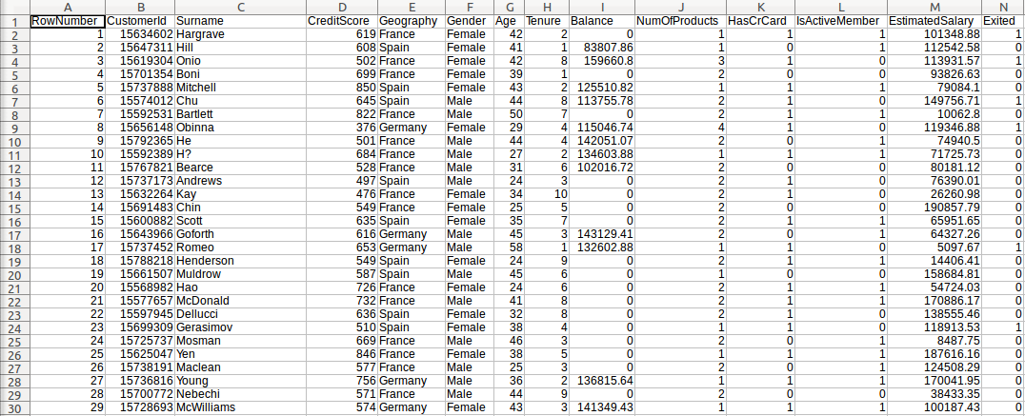
Data Preprocessing Churn Modelling Dataset
Given the dataset, the Machine learning task is to be able to predict which customers are likely to exit the bank or stay.
This is a classification task!

Slide 41
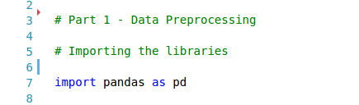

Data Preprocessing
#Import the dataset
7: Import Pandas library
10:Load the dataset from disk.
11: Slice the dataset (and get the features we need) from index 4 to index 13.
12: Slice the dataset and get the target label (the dependent variable) at index 14.

Slide 42
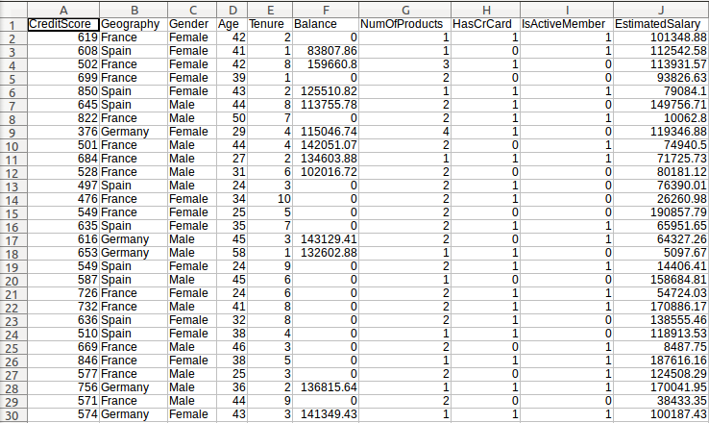
Data Preprocessing Independent variables for training
Now we have sliced out our relevant independent variables needed for training, from the original dataset

Slide 43
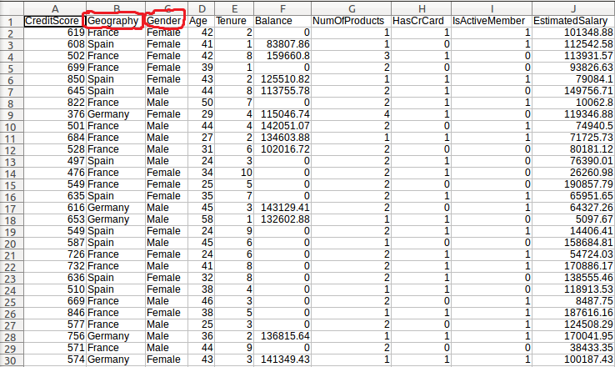
Data Preprocessing Identifying and handling labels and categories
The Geography and Gender features are text-values so we need to convert them to numerical values. This is called label encoding.
These features are also categorical, that is, the classify a feature into a category e.g. Spain, France, Male, female etc. We’ll need to one-hot encode them. Why do we need to one-hot encode?
The Geography and Gender fields are text-values
and are also categorical

Slide 44
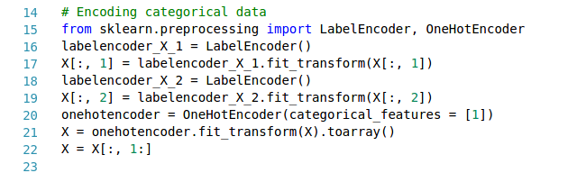
Data Preprocessing
#Encoding categorical data
15: Import the necessary library and its classes
16: Create the LabelEncoder object for the first text feature.
17: Label encode the feature using the fit_transform class and overwrite the old values in the dataset.
18 & 19: Repeats line 16 and 17 for the second text feature in the dataset.

Slide 45
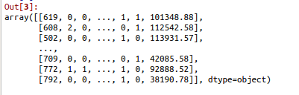
Data Preprocessing Why do we need to one-hot encode?
Label encoding a text-valued categorical feature assigns a numerical value to each category.
If our categories are not ordinal i.e. there is no relational order in which the categories appear. Then we should one-hot encode.
One-hot encoding prevents the learning algorithm from placing importance on the manner in which the categorical values are listed.
When we one-hot encode, we take the categorical values and represent each one in its own column as a dummy variable.
Label encoded array. Notice that the Geography
and Gender fields are now numbers

Slide 46
Data Preprocessing
#Encoding categorical data
20: Create the onehotencoder object, the parameter “categorical_ features” specifies the index of the categorical feature in the dataset.
21: We onehotencode the ‘Geography’ feature at index 1.
22: We drop one of the newly created dummy variables at index 1. The final dataset has 11 features.

Slide 47
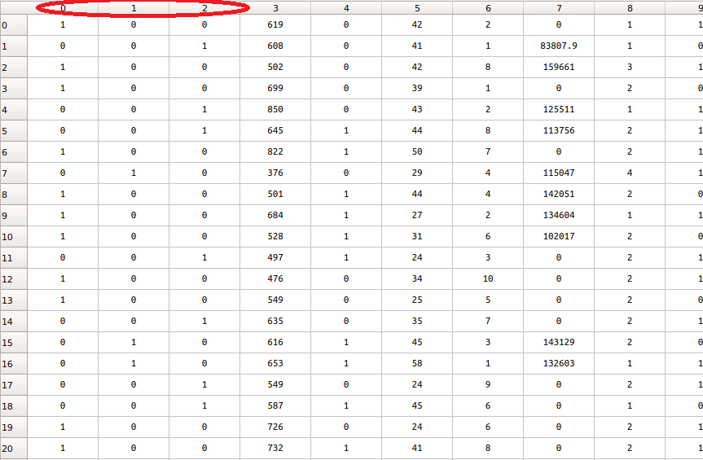
Data Preprocessing The Dummy variable trap
The dummy variable trap is a scenario where two or more independent variables are multicollinear.
This means that if we know the value of one, we can estimate the value of the other quite accurately.
After executing line 21 in the source code, our dataset now contains three new dummy variables.
Notice that each column represents a category, in this case a country.
If we know the value of the first two columns, we can accurately guess the value of the third. The 3 dummy variables are multicollinear.
This is why we drop one dummy variable in line 22 to avoid the dummy variable trap. It is for this same reason we do not onehotencode the “Gender” feature.
Three Dummy variables have been added. This leads
to the dummy variable trap

Slide 48
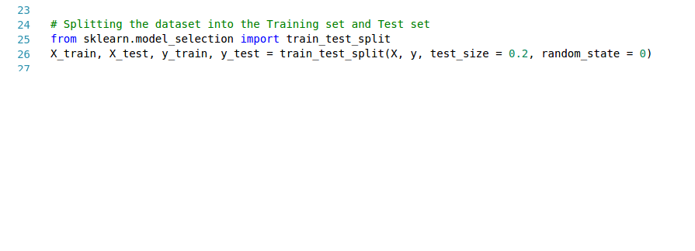
Data Preprocessing Cross validation
Cross validation is the practice of separating the training set from the test set, so that we can evaluate more accurately, the performance of a machine learning model.
#Split the dataset into training and test set
25: Import the necessary class
26: The train_test_split class takes as parameters;
an array of the training features (X)
an array of the target variable (y)
test_size specifies the ratio of the traning data to the test data. In this case 0.2 means 20% of the overall dataset is reserved as the test data, and of course 80% is used as the training data.

Slide 49
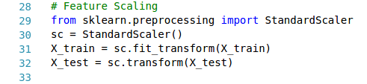
Data Preprocessing Feature scaling
Feature scaling ensures that the training and test set values are scaled to a uniform range so that the learning algorithm does not place a higher precedence on larger numerical values.
#Feature Scaling
29: Import the StandardScaler
30: Create object of the StandardScaler class
31: Fit and scale the training data using ‘fit_transform’
32: Scale the test data using the same object instance and the ‘transform’ method so that both training and test set are scaled uniformly.

Slide 50
Data preprocessing (Recap)
Data preprocessing prepares our dataset before we feed it to the learning algorithm. In general the following are key data preprocessing practices;
Feature engineering
Label encoding and One-hot-encoding
Feature scaling (Standardization or Normalization)
Cross validation (Separating the training and test set)
Other data preprocessing techniques exist for Computer vision and Natural language processing (NLP) machine learning problems.

Slide 51
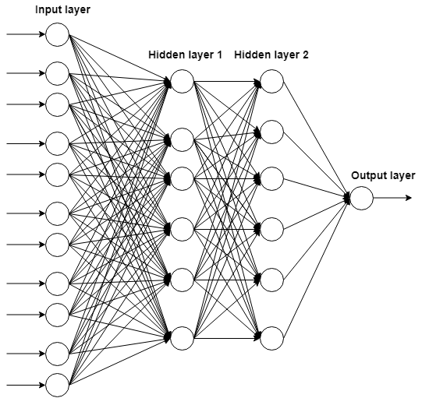
Building the ANN
We’ll be building a four layer deep artificial neural network

Slide 52
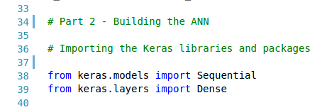
Building the ANN
#Importing the Keras libraries and packages
38: Import the Sequential API from Keras.models. This enables us build the neural network graph by adding the layers (and its properties) sequentially, one of after the other.
39: Import the Dense class, this will enable us build fully connected layers where all the nodes are linked to each other.
Keras Documentation

Slide 53
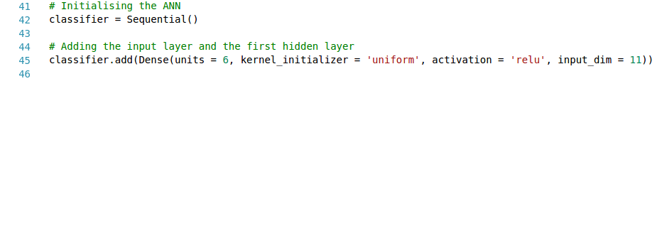
Building the ANN
#Adding the input layer and first hidden layer
42: Initialize the Sequential class by creating an object instance. We name it classifier because we are building a classifier.
45: You can use the add() method to each layer. Then we use the Dense class to structure the layer. The parameters are;
Units: the number of nodes in the layer
Kernel_initializer: Set the initial random weights of the Keras layer
Activation: the activation function for the nodes
Input_dim: The number of input nodes to the layer (Only defined for the first hidden layer).

Slide 54
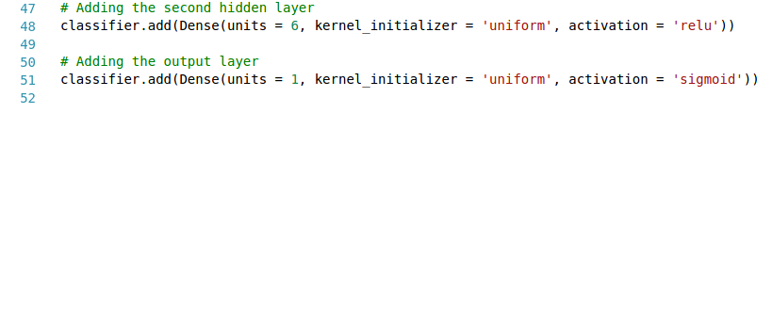
Building the ANN
#Adding the second hidden layer
48: Use the add() method again, to add the second hidden layer. The parameters used are the same as the first hidden layer except for the ‘input_dim’ parameter.
#Adding the output layer
45: Finally we add the output layer. The output layer has only one node, and we use the sigmoid function for the classification task.

Slide 55
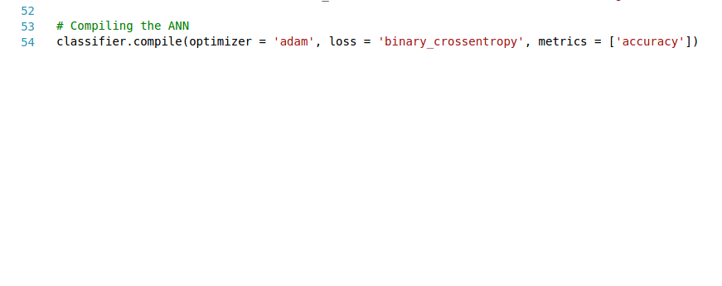
Building the ANN
#Compiling the ANN
Use the compile() method to configure the network for training.
48: The parameters for the compile() method used are;
optimizer: an instance of the gradient descent optimizer
loss: The cost function or objective function for the network
metric: List of metrics to be evaluated by model during the training and testing.

Slide 56
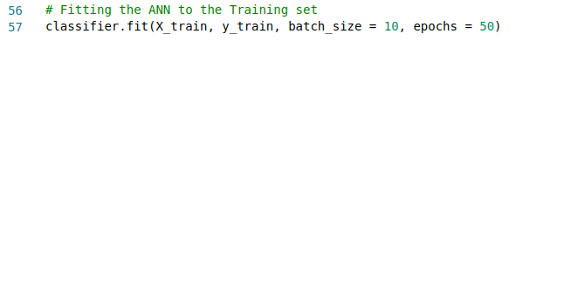
Training the ANN
#Training the ANN
When we train a machine learning model, we ‘fit’ the model to the training data.
Use the fit() method to train the model
48: The parameters for the fit() method used are;
X: Numpy array of training data
Y: Numpy array of target data
batch_size: Number of samples per gradient update
epochs: an epoch is the number of iterations over the entire X and Y data. This parameter specifies the number of epochs to train the model.

Slide 57
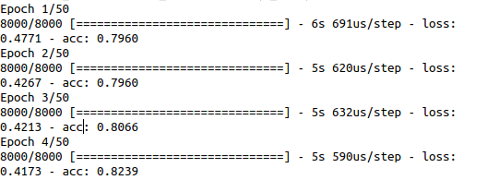
Training the ANN
Screenshot of the training procedure showing the epoch, loss and accuracy

Slide 58
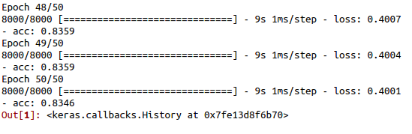
Training results
Training Loss: 0.4001; Training Accuracy: 0.8346

Slide 59
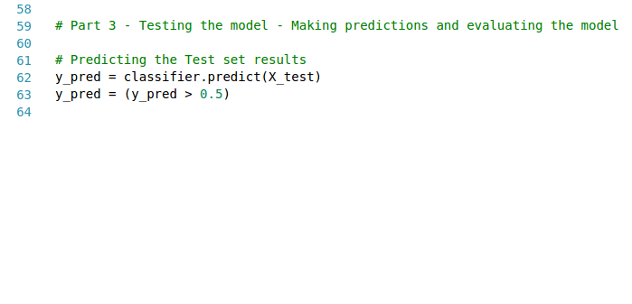
Testing the ANN
#Testing the model
In order to validate the performance of the model, we evaluate its performance on the test set. Use the predict() method to test the model on the test set (X_test)
62: The parameters for the predict() method is the test dataset stored in X_test.
63: The predicted values stored in y_pred range from 0 to 1. This is due to the fact that we made use of the sigmoid function in the output node. In line 63 we are simply saying, store any value greater than 0.5 as 1 and values less than 0.5 as 0.
So a 1 represents a positive that the customer is likely to exit;
And a 0 represents a negative that the customer is likely to exit.

Slide 60

Testing the ANN Confusion matrix
#Making the confusion matrix
The confusion matrix provides a means of evaluating the accuracy of a binary classification (See sklearn documentation)
66: Import the confusion_matrix class.
63: The parameters for confusion_matrix are the ground truth (correct values, y_test) and the predicted values (y_pred).

Slide 61


Testing the ANN ...more on the confusion matrix
In the figure on the right, we can see the values of the confusion matrix.
In the matrix;
Index 0,0 represents the number true negatives
Index 0,1 represents the number of false positives
Index 1,0 represents the number of false negatives
Index 1,1 represents the number of true positives
To get the accuracy,
$$acc=\frac{true negatives+true positives}{total values} ×100$$
$$\frac{1502+216}{2000} ×100=85.9\%$$
Confusion matrix

Slide 62

Plotting and Saving Keras model
#Plotting (visualizing) the keras model
72: Import the plot_model class from keras.utils
73: The parameters needed are the keras model instance, and the file name to save the plotted model.
#Saving the keras model
77: Use the to_json() method to return a representation of the model as a JSON string.
78 & 79: Write the contents of model_json in line 77 to file on disk ‘model.json’
81: Save the weights of the model as a HDF5 file.

Slide 63

Plotting and Saving Keras model
Conceptualized Neural network architecture
Keras representation of the model

Slide 64

Loading Keras model (From disk)
#Loading the keras model
88: Import the model_from_json class from keras.models
89-91: Read the json file containing the model from disk and store in a variable.
92: Use model_from_json to process the json file and create an instance of the keras model
94: load the model weights using the load_weights() method.
98: Compile the loaded model
101: Make predictions with the loaded model

Slide 65
Practical Session Recap
Data preprocessing using Sci-kit learn’s LabelEncoder and OneHotEncoder class.
Cross validation using Sci-kit learn’s train_test_split class.
Feature scaling using Sci-kit learn’s StandardScaler class.
Built the ANN using the Keras.models.Sequential functional API and Keras.layers.Dense class.
Evaluated the training results
Tested the model on a test set
Evaluated the test set performance using the confusion_matrix class
Plotted and Saved the model using Keras plot_model() and to_json() methods
Loaded the model using Keras model_from_json() and load_weights() method.

Slide 66
Home work
On your own, try to make a single prediction (on one customer) using the deep learning model you built.

Slide 67
Future work
Try training the model for more epochs. Does this improve accuracy?
Try to improve the models performance by looking into regularization techniques e.g. Dropout.
Build a regression model using Keras!
Keras has multiple layers for Computer vision and Natural language tasks; try to implement a project in one of these applied areas
Further reading on the theoretical concepts behind deep learning.
Recommended Book on Deep learning with Python;
Deep learning with Python by François Chollet

Slide 68
Thank you and Goodluck!

